Slide 1
CIVL 4210 - Advanced Construction with AI and Robotics Guidebook: Data Visualization
Prof. Yu
HUANG Xuhong
The Hong Kong University of Science and Technology (HKUST)

Slide 2
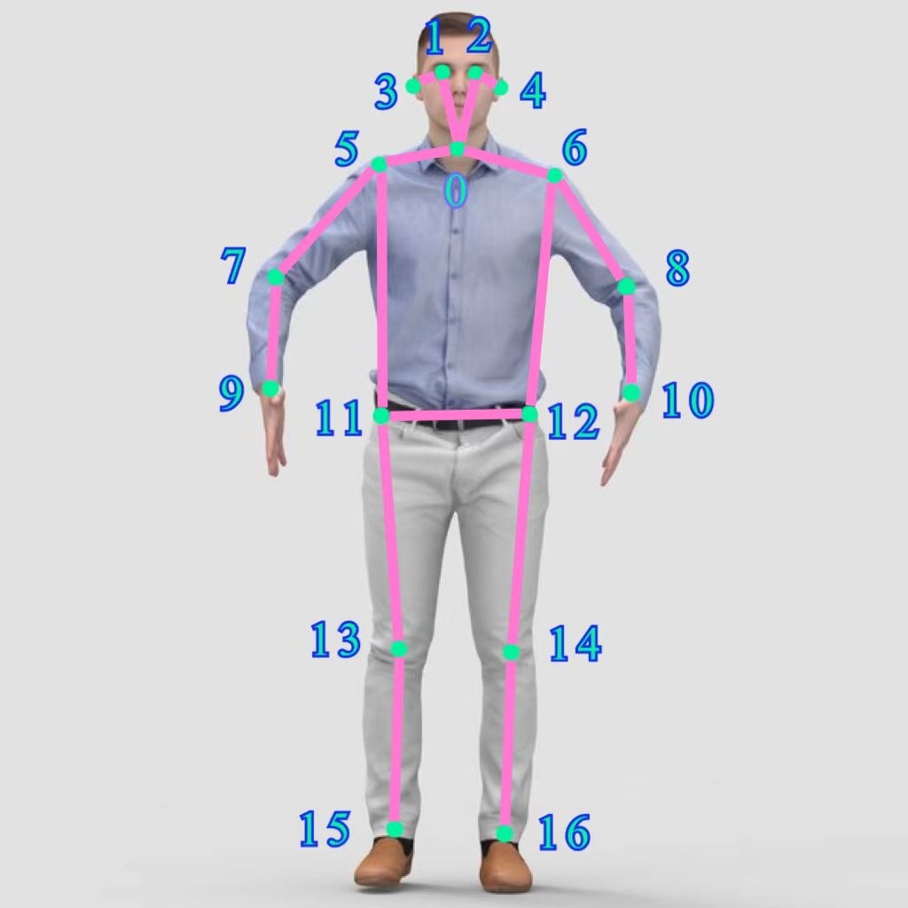
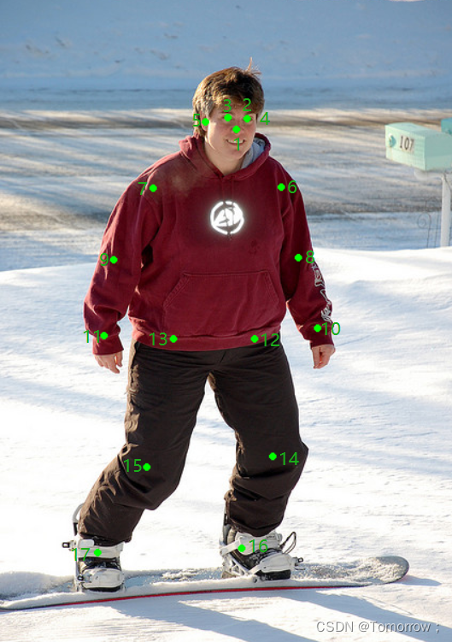
Background
1.Human Pose Estimation - keypoint
In order to represent the human pose, the human body is usually divided into different keypoints, such as the COCO dataset with 17 keypoint types. The body parts 17 key points include:
0: nose, 1: left eye, 2: right eye, 3: left ear, 4: right ear, 5: left shoulder, 6: right shoulder, 7: left elbow, 8: right elbow, 9: left wrist, 10: right wrist, 11: left crotch, 12: right crotch, 13: left knee, 14: right knee, 15: left ankle, 16: right ankle.
2.Matplotlib
Matplotlib is a drawing library for the Python language and its numerical computation library NumPy. It can draw 2D and 3D pictures.

Slide 3
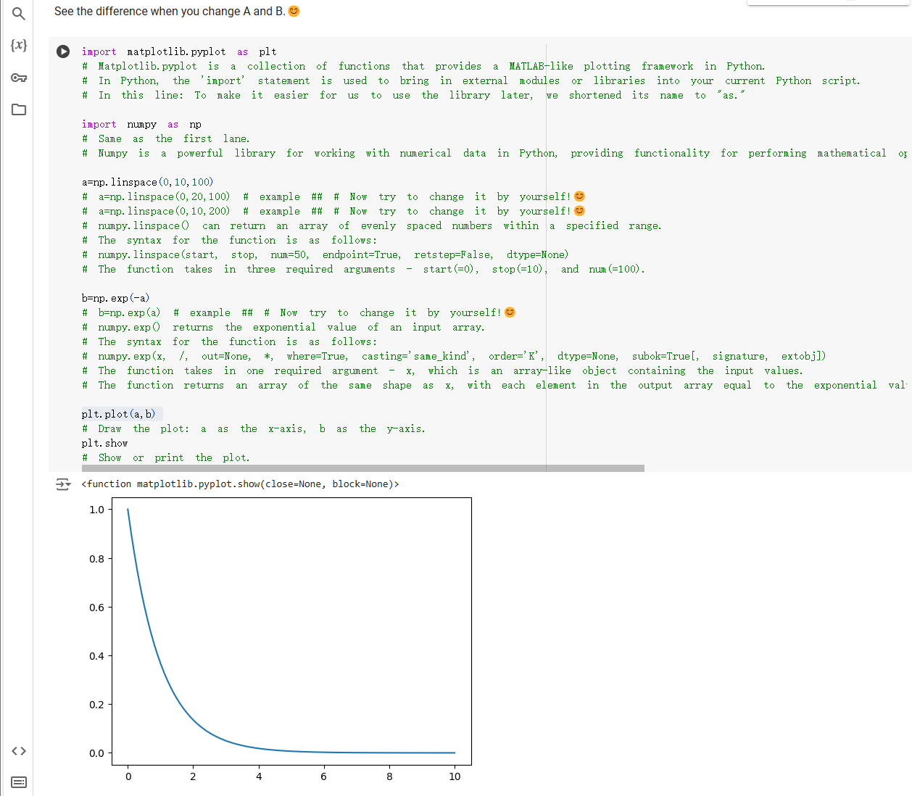
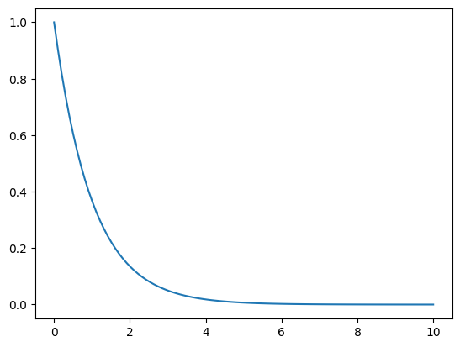
Step 1: Plot a curve
Step 1：Import model
Step 2：Creat array
Step 3：Draw the squares of array
import matplotlib.pyplot as plt
import numpy as np
a=np.linspace(0,10,100)
b=np.exp(-a)
plt.plot(a,b)
See the difference when you change “a” and “b”.😊

Slide 4
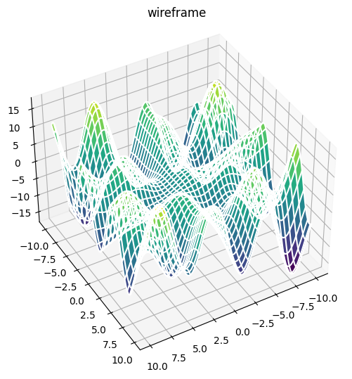
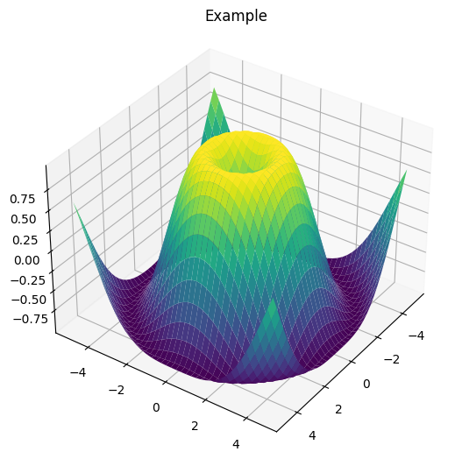
Step 2: Draw a surface
Step 1：Import model
Step 2：Creat array
Step 3：Draw the squares of array
import matplotlib.pyplot as plt
from mpl_toolkits.mplot3d import Axes3D
import numpy as np
from matplotlib.pyplot import MultipleLocator
fig=plt.figure()
ax=fig.add_axes(Axes3D(fig))
X=np.arange(-5,5,0.25)
Y=np.arange(-5,5,0.25)
X,Y=np.meshgrid(X,Y)
R=np.sqrt(X**2+Y**2)
Z=np.sin(R)
surf=ax.plot_surface(X,Y,Z,cmap='viridis')
ax.set_title('Example')
ax.view_init(35,35,0)
plt.show()
Try to change 'X,Y arange', 'R', 'Z', 'surf', 'view_init'😊

Slide 5
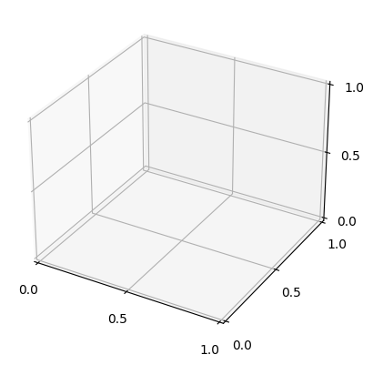
Step 3: Drawing of human posture
Step 1：Fire up
matplotlib create
Step 2：Establish connections between keypoints
Step 3：Build 3D image with
Matplotlib. pyplot module
from mpl_toolkits.mplot3d import Axes3D
import matplotlib.pyplot as plt
import numpy as np
from matplotlib.pyplot import MultipleLocator
def renderBones(): # define a function
link = [[0,2],[0,3],[2,5],[3,6],[1,5],[1,6]
,[5,11],[11,15],[6,12],[12,16]
,[3,8],[8,14],[14,17],[2,7],[7,13],[13,18]
,[1,4],[4,9],[4,10]]
for l in link:
index1,index2 = l[0],l[1]
ax.plot([xs[index1],xs[index2]], [ys[index1],ys[index2]], [zs[index1],zs[index2]], linewidth=1, label=r'$z=y=x$')
x_major_locator = MultipleLocator(0.5)
fig = plt.figure()
ax = fig.add_subplot(111, projection='3d')
ax.xaxis.set_major_locator(x_major_locator)
ax.yaxis.set_major_locator(x_major_locator)
ax.zaxis.set_major_locator(x_major_locator)
x_major_locator = MultipleLocator(0.5)

Slide 6
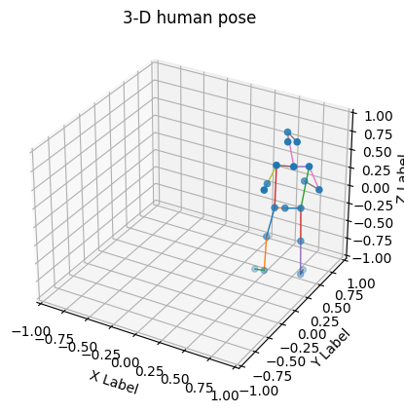
Step 3: Drawing of human posture
Step 4：Read the data
Step 5：Draw 3-D human pose
import urllib.request
url='https://raw.githubusercontent.com/Yokhong/CIVL4210/main/H2_human_pose_in_3D_space/humanpose_data.txt'
urllib.request.urlretrieve(url, "/content/humanpose_data.txt")
file="humanpose_data.txt" # relative address (computing)
# file="/content/humanpose_data.txt" # absolute address (computing)
nl=[]
with open (file) as f :
for line in f:
nl.extend([float(i) for i in line.split()])
xs=nl[0:19]
print(xs)
ys=nl[19:38]
print(ys)
zs=nl[38:57]
print(zs)
fig = plt.figure()
ax = fig.add_subplot(111, projection='3d')
renderBones()
ax.scatter(xs,ys,zs)
ax.set_xlabel('X Label')
ax.set_ylabel('Y Label')
ax.set_zlabel('Z Label')
ax.set_xlim(-1,1)
ax.set_ylim(-1,1)
ax.set_zlim(-1,1)
ax.view_init(40,60,0)
ax.set_title('3-D human pose')
plt.show()

Slide 7
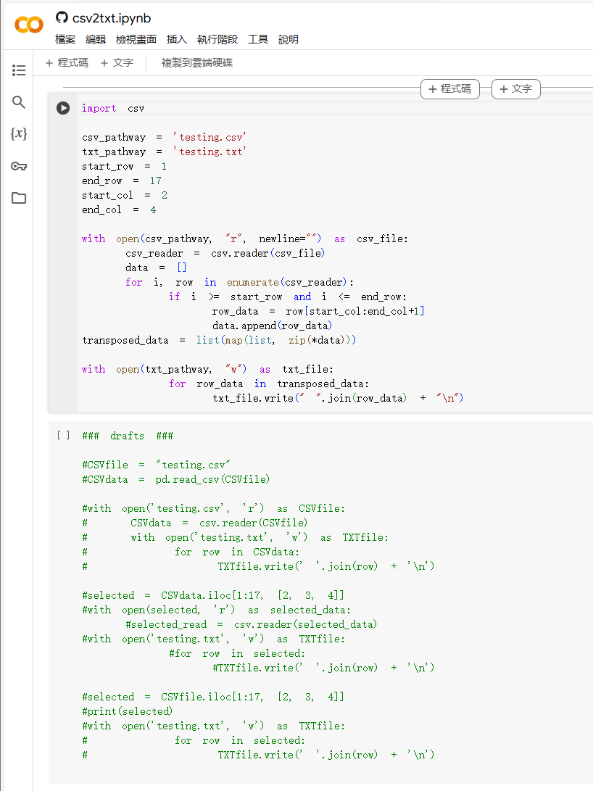

Changing File Formats
Convert .csv format to .txt format.

Slide 8
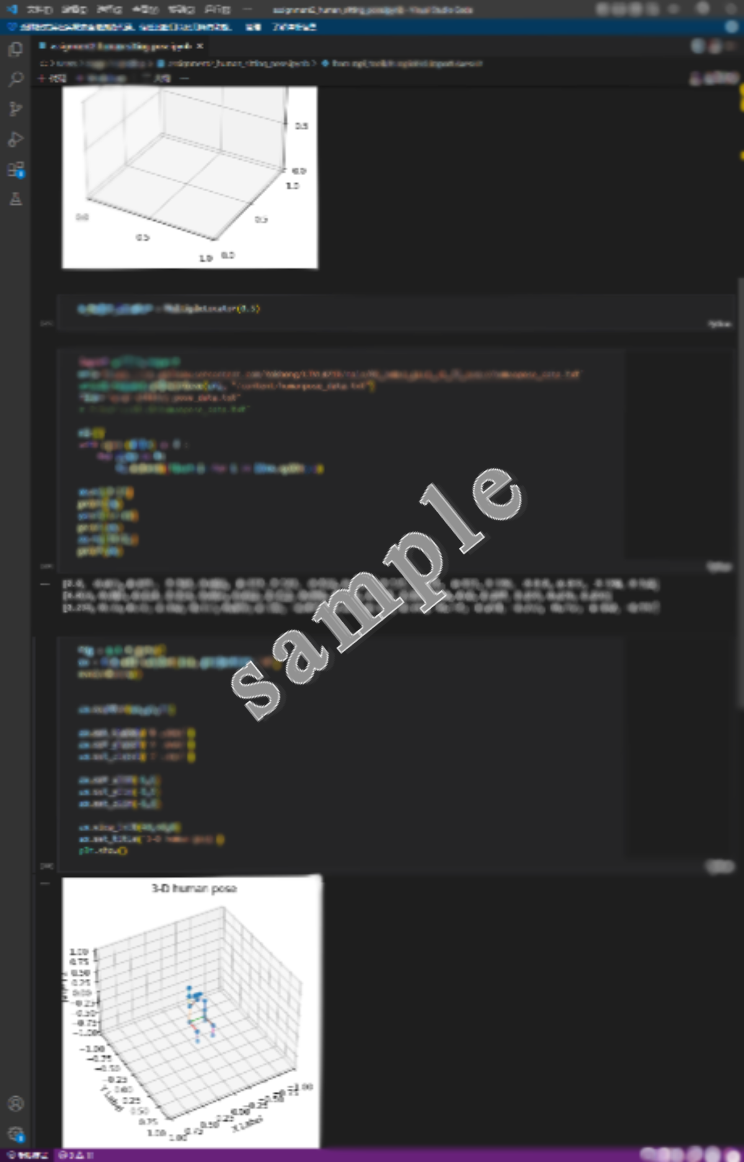
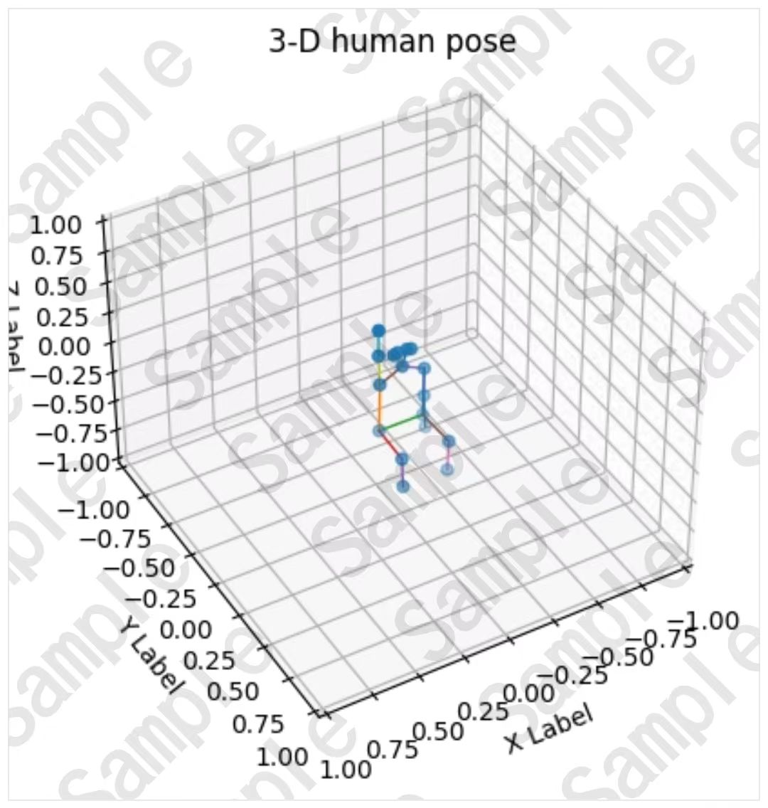
Assignment requirement
1. Change the raw data into the format that your code can read.
2. Define a function in which you can join the key points together.
3. Load the files you changed and print out XS, YS, and ZS.
4. Change the view to elevation angles of 40, azimuth angles of 60, and rotation angles of 0.
5. Plot the 3D human pose and save the picture on your computer.
What you need to submit in Canvas are an ipynb file and a picture of the 3D human pose.

Slide 9
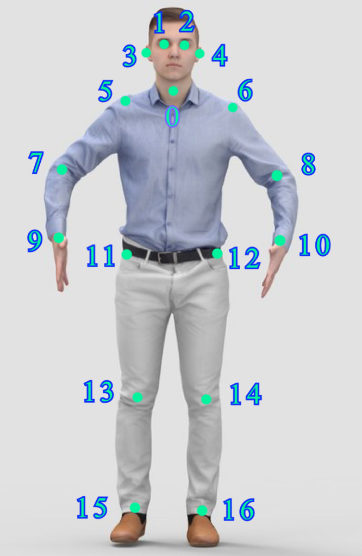
Appendix
NUMBER | NAME
0 | neck
1 | L-eye
2 | R-eye
3 | L-ear
4 | R-ear
5 | L-shoulder
6 | R-shoulder
7 | L-elbow
8 | R-elbow
9 | L-wrist
10 | R-wrist
11 | L-hip
12 | R-hip
13 | L-knee
14 | R-knee
15 | L-ankle
16 | R-ankle

